Slide 1

Computer Organization
Programming Assignment 2

Slide 2
Outline
Introduction
Homework file structure
Performance measurement
RISC-V extension
Test your answer
Submission

Slide 3
Introduction
Finish your assembly code
Collect performance data
Rewrite code with Vector extension
Collect performance data again
Get improvement ratio

Slide 4
Introduction
Question1
Implement assembly code for sum of element in array.
Insert instruction counter to above assembly code to collect performance data.
Compute instruction count and CPU time.
Improve origin assembly code with Vector extension.
Insert instruction counter again.
Compute new instruction count and new CPU time.
Question2
Implement assembly code for given problem.
You can get higher score if your performance achieve the requirement.

Slide 5
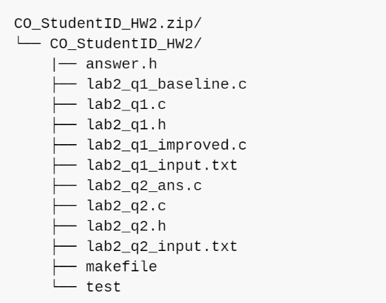
Homework file structure
Lab2 question1
lab2_q1.c: main file, starting from this file.
lab2_q1.h: definition of lab2_q1.c.
lab2_q1_baseline.c:implementation answer here.
lab2_q1_improved.c:implementation answer here.
answer.h: compute performance here.
lab2_q1_input.txt: test data.
Lab2 question2
lab2_q2.c: main file, starting from this file.
lab2_q2.h: definition of lab2_q2.c.
lab2_q2_ans.c:implementation answer here.
lab2_q2_input.txt: test data.
Common
makefile: help you compile and run code.
test: auto testing

Slide 6
Homework file structure
You should write your answer in
lab2_q1_baseline.c
lab2_q1_improved.c
answer.h
lab2_q2_ans.c
Don’t modify other files. But you can read other files to help you finish your homework.

Slide 7
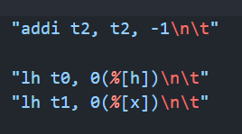
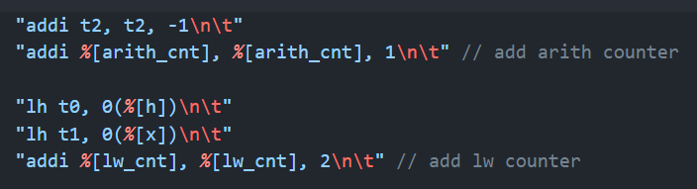
Performance measurement
arith_cnt: add, sub, and, vadd.vv …
lw_cnt: lw, lh, vle32.v …
sw_cnt: sw, sh, vse32.v …
others_cnt: other instruction
Refer to document for details.
Add counter to get performance

Slide 8
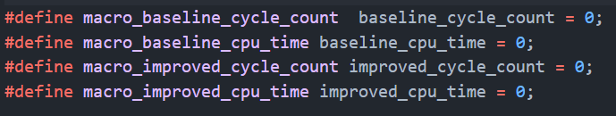
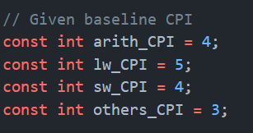
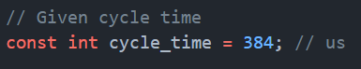
Performance measurement
In answer.h file, you should compute cycle count and cpu time here.
You should refer lab2_q1.h to finish answer.h.

Slide 9
RISC-V extension
Some useful vector extension instruction: vsetvli, vle16.v vle32.v, vse16.v, vse32.v, vadd.vv, vmseq.vv…
Read V extension spec(how to use instruction, read example).
riscv-v-spec-1.0.pdf

Slide 10
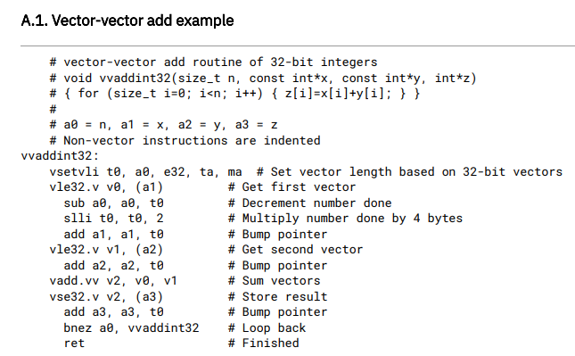
RISC-V extension

Slide 11
Test your answer
Get Score:
$ make score
you will get right answer, your answer and total score.
Test your first problem
$ make lab2_q1
$ make run_lab2_q1 TEST_DATA=1
TEST_DATA=1~10
Test your second problem
$ make lab2_q2
$ make run_lab2_q2 TEST_DATA=1
TEST_DATA=1~10

Slide 12
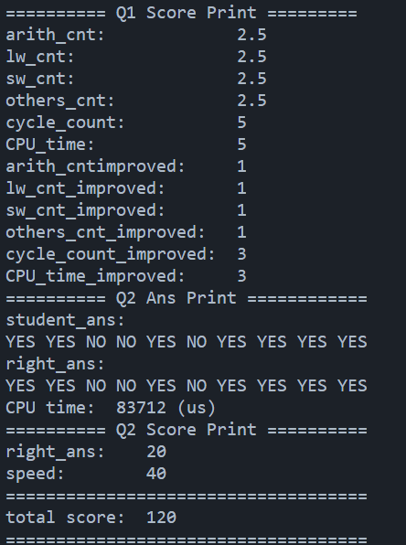
Test your answer
Answer print
Your final score

Slide 13
Submission
Upload your homework to Moodle.
The expected arrangement of your codes:
Only .zip types of compression are allowed.
The directory should be organized as shown in document.
You will lose 10pt if your programs were uploaded in incorrect format!!!

Slide 14
Deadline
Postpone
30% off
Scoreless
4/13
Hw2 release
5/10
23:59 Deadline
5/17
23:59

Slide 15
How to Mail TAs
Send mail to asrlab@csie.ncku.edu.tw, not any TA’s mail!!
Email subject starts with “[Comp2023]”
Thoroughly read document before asking questions.

Slide 16
QUESTIONS ?

